Slide 1
SPELLING AND GRAMMAR CHECKING APP
By
Simmy Xavier
(MST03-0069)
SUBMITTED TO META SCIFOR TECHNOLOGIES PVT LTD

Slide 2
Objective
Objective: Develop a tool for checking spelling and grammar in text.
Key Components:
Spelling correction using autocorrect.
Grammar correction using LanguageTool.
Definition retrieval via online dictionary API.
Outcome: Accurate text correction and useful suggestions.

Slide 3
Introduction
Context: Importance of accurate text in written communication.
Purpose: Create an application that improves text quality by checking and correcting spelling and grammar.
Technologies: Python libraries for spelling, grammar, and definitions.

Slide 4
Technology Stack
Programming Language: Python
Libraries:
autocorrect: Spelling correction
language_tool_python: Grammar correction
requests:
Purpose: Manages HTTP requests to external services.
Used to make GET requests to the DictionaryAPI to fetch word definitions.
API: Online dictionary API
DictionaryAPI (dictionaryapi.dev):
Purpose: Provides definitions of words.
Usage: Accessed to retrieve definitions for corrected words, enhancing the user’s understanding of the corrections

Slide 5
Functionality Overview
Spelling Correction:
Detects and corrects misspelled words.
Provides word definitions.
Grammar Correction:
Identifies and suggests fixes for grammatical errors.
Definition Retrieval:
Fetches definitions for corrected words using an API.

Slide 6
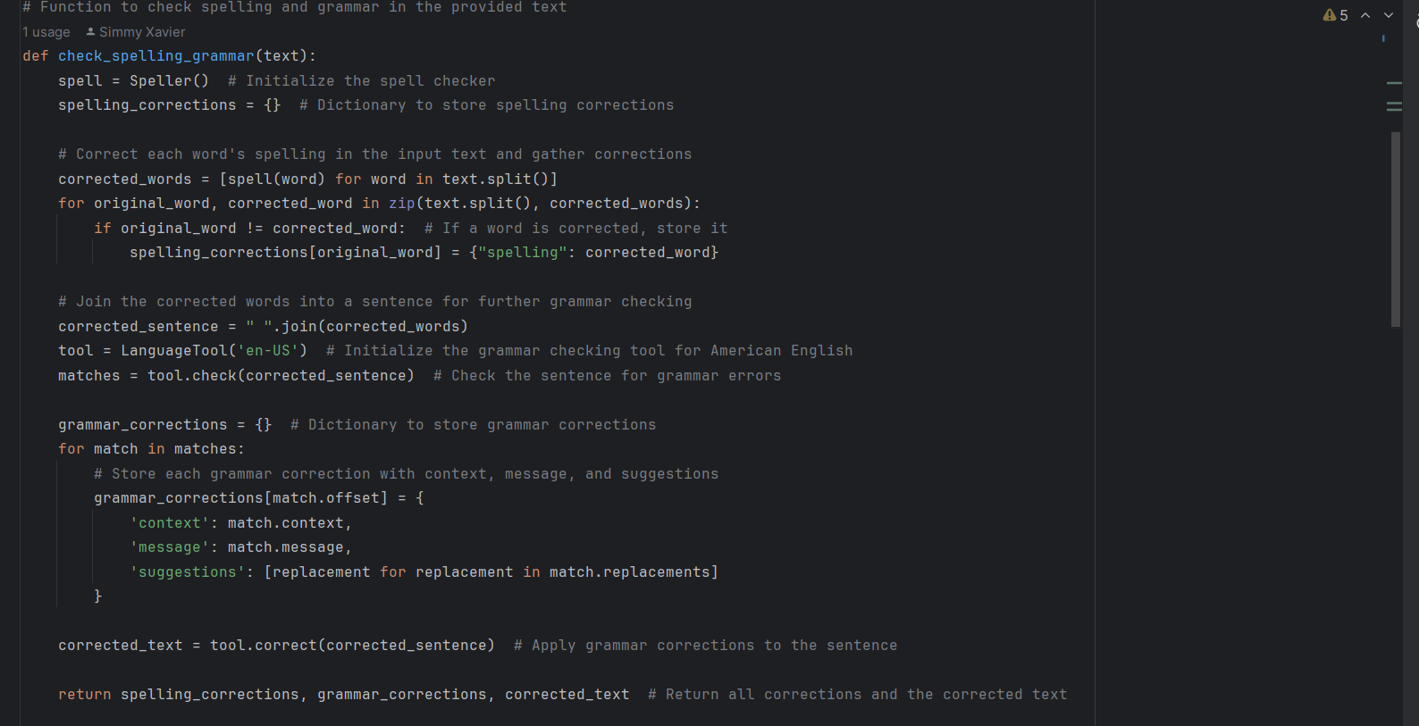
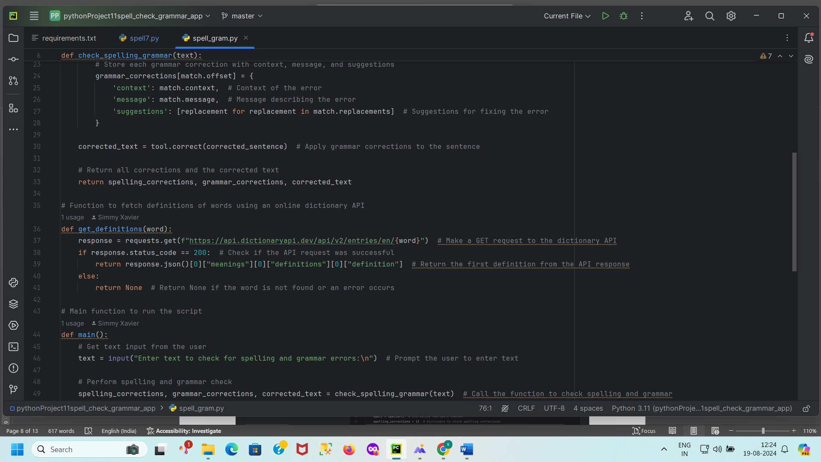
How It Works
Spelling Correction:
Use autocorrect to correct spelling mistakes.
Gather corrections and definitions.
Grammar Correction:
Use language_tool_python to check and correct grammar.
Definition Retrieval:
Fetch word definitions from an online API.
Output:
Display spelling and grammar corrections.
Show corrected text and word definitions.

Slide 7
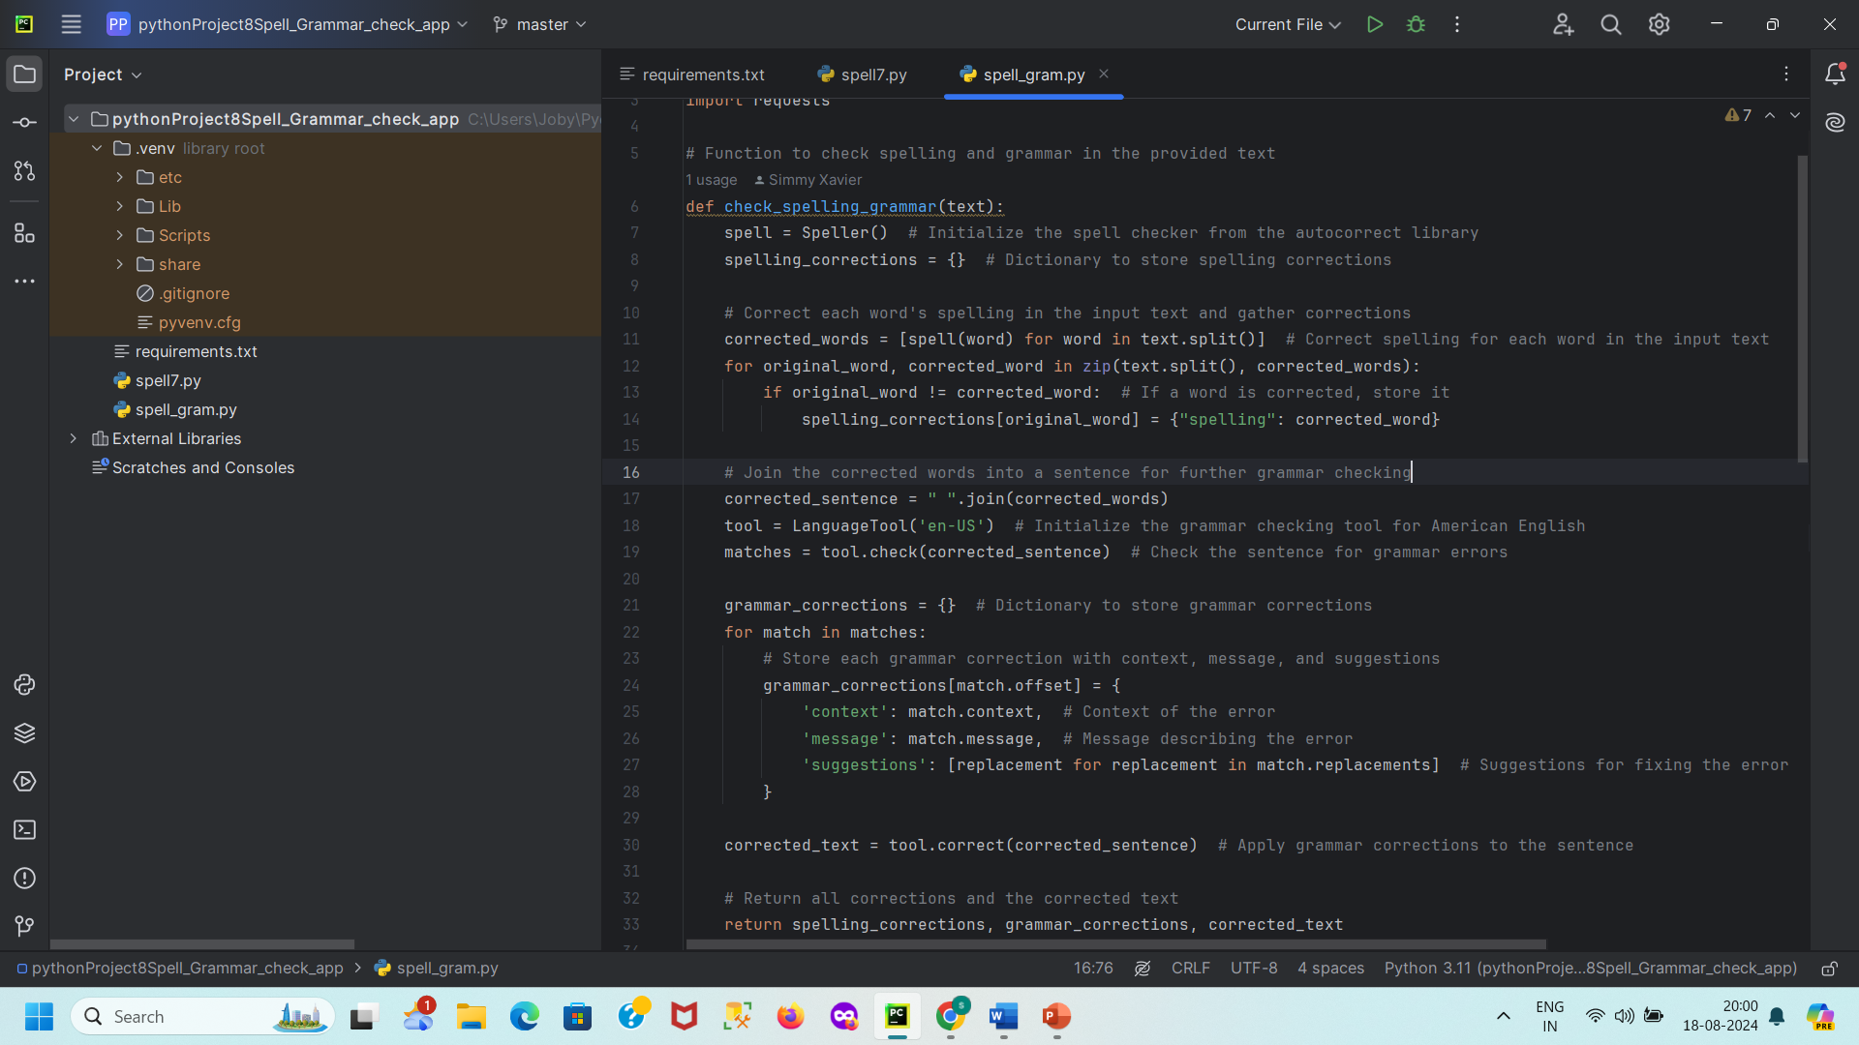
Code Snippet - Spelling Correction
Function: check_spelling_grammar(text)
Highlights:
Initializes spell checker.
Corrects spelling and gathers corrections.
Uses language_tool_python for grammar checks.
Retrieves and displays definitions.

Slide 8
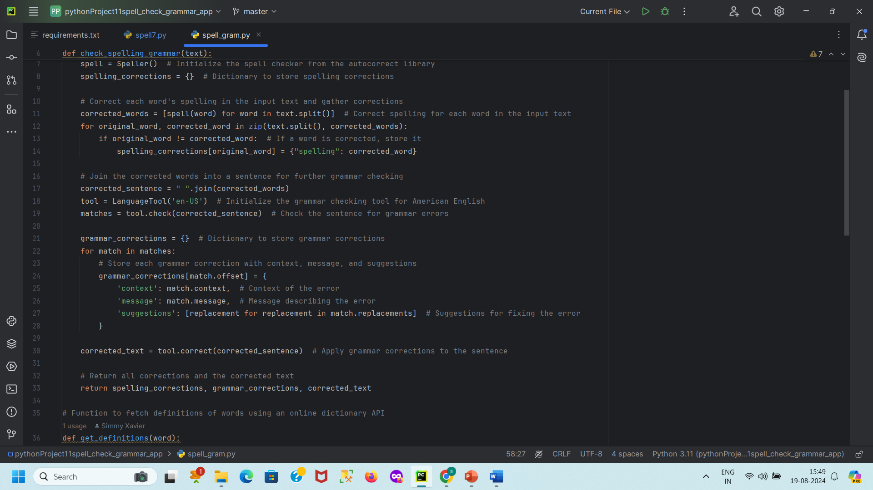
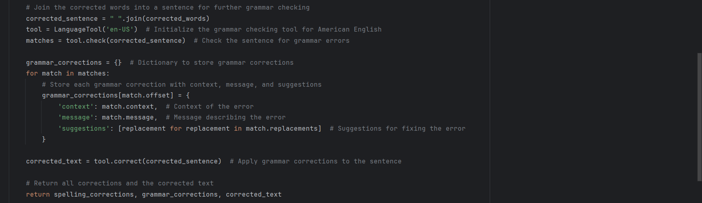
Code Snippet - Grammar Correction
Function: check_spelling_grammar(text)
Highlights:
Initializes grammar tool.
Identifies and stores grammar errors.
Applies corrections to the text.

Slide 9
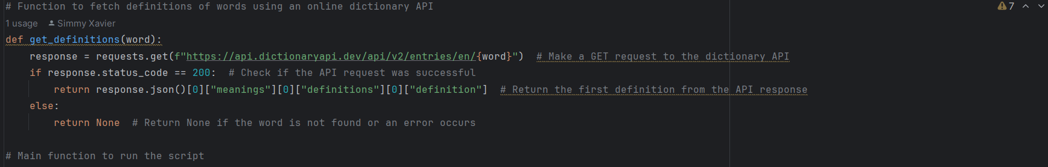
Code Snippet - Definition Retrieval
Function: get_definitions(word)
Highlights:
Fetches definitions from an online API.
Handles API responses and errors.
def get_definitions(word):
response = requests.get(f"https://api.dictionaryapi.dev/api/v2/entries/en/{word}")
# Additional code...

Slide 10
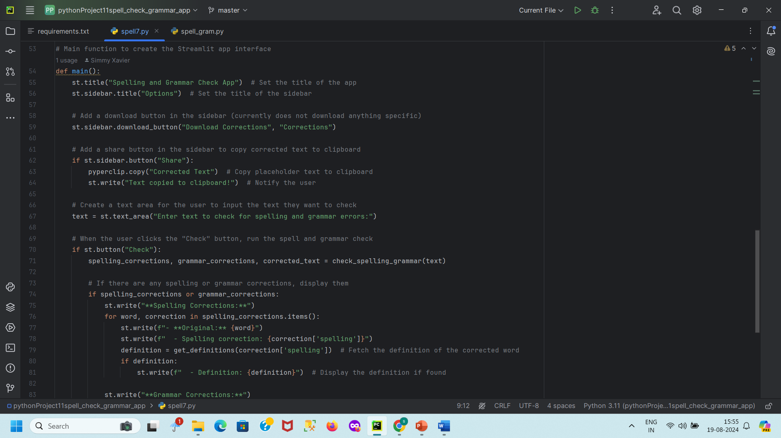
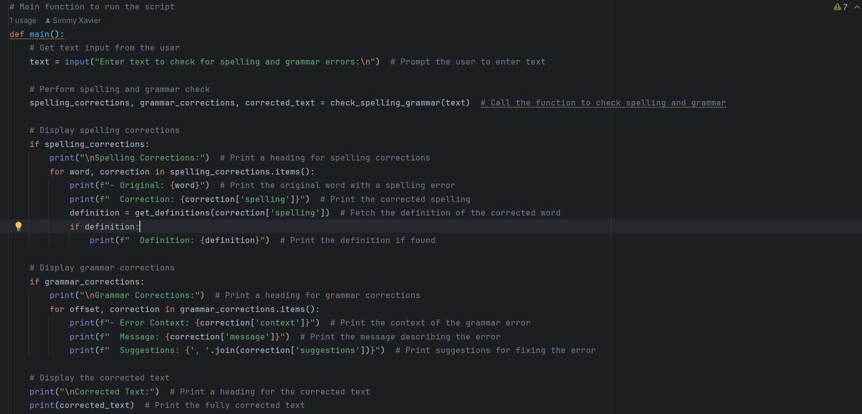
User Interface
Input: User enters text for checking.
Output: Displays spelling corrections, grammar corrections, and definitions.
Interactive Elements:
File upload for text files.
Input fields for direct text entry.

Slide 11
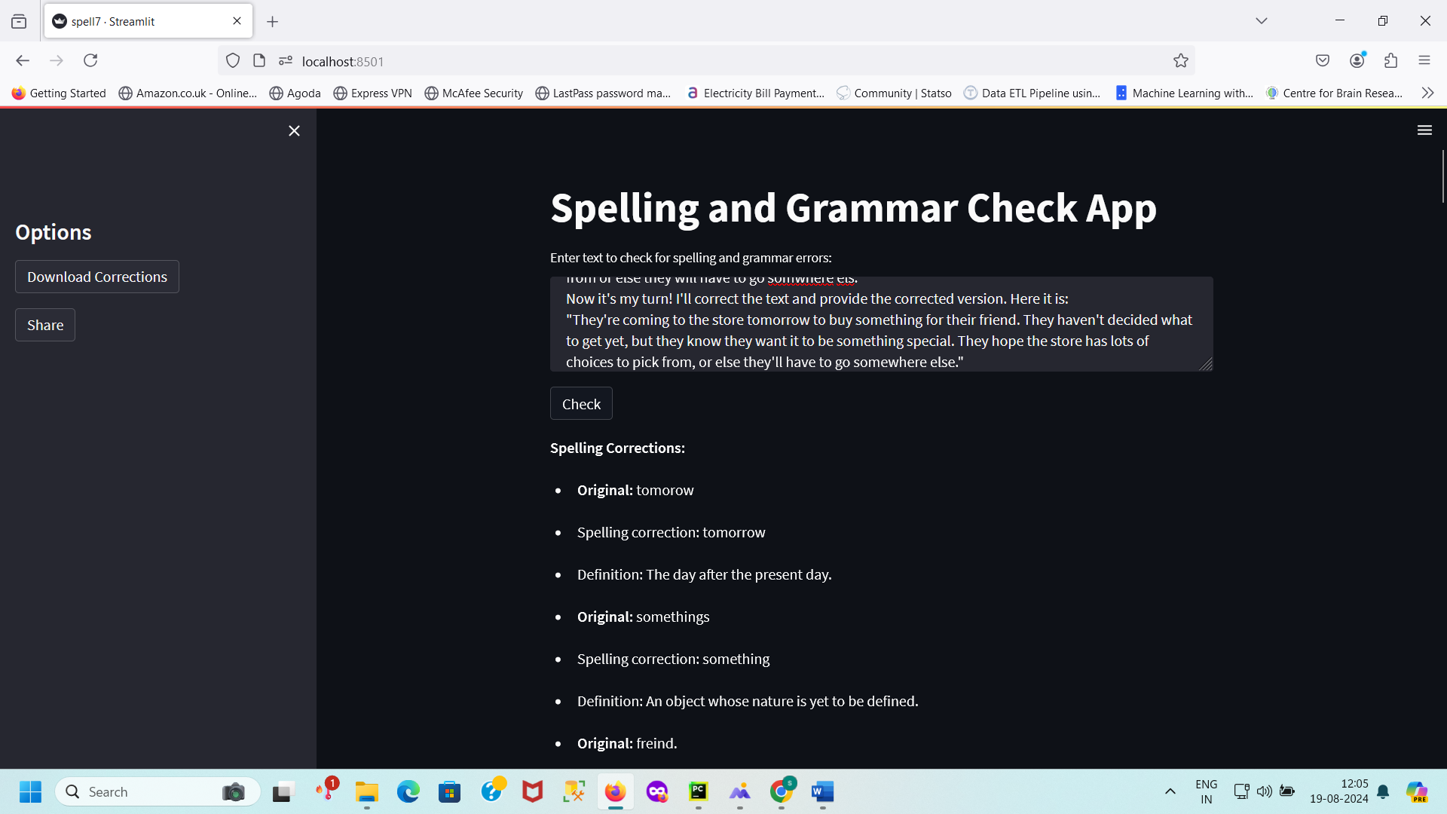
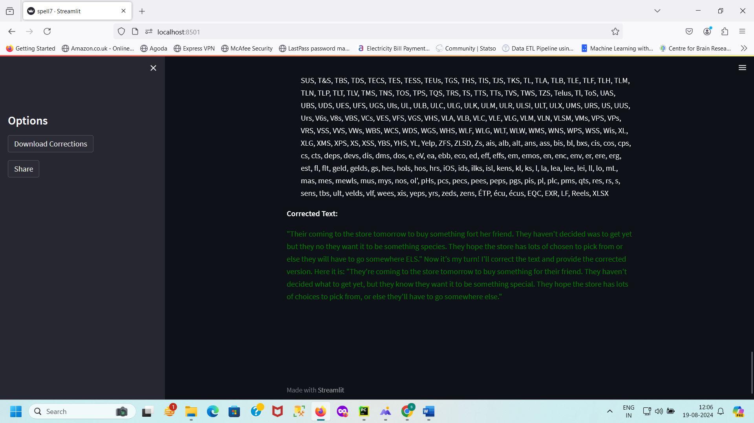
Results
Spelling Corrections:
Identification and Correction: The application accurately detects and corrects misspelled words in the input text.
Correction Storage: Corrected words are mapped to their original misspelled forms, providing a clear view of what was changed.
Definition Retrieval: Definitions of corrected words are fetched from an online dictionary API, offering additional context and understanding.
Grammar Corrections:
Error Detection: Grammar errors are effectively identified using LanguageTool.
Detailed Feedback: Each grammar issue is described with context, an explanatory message, and suggestions for improvement.
Correction Application: The application automatically applies grammar corrections to the input text.
User Interface:
Interactive Design: The Streamlit-based web interface allows users to input text and receive feedback in an intuitive manner.
Clipboard Functionality: Users can copy the corrected text to the clipboard for easy use elsewhere.
Correction Viewing: Users can view detailed spelling and grammar corrections directly in the application.
Text Preprocessing:
Spelling Correction First: Text is processed to correct spelling errors before grammar checking, ensuring accurate grammatical analysis.
Sentence Assembly: Corrected words are combined into a coherent sentence for comprehensive grammar checking.
Definitions and Suggestions:
Word Definitions: Definitions of corrected words are provided, enhancing user comprehension.
Grammar Suggestions: Suggestions for grammar improvements are offered, helping users understand and apply corrections.

Slide 12
Conclusion
Effective Text Correction:
The application successfully detects and corrects both spelling and grammar errors in user-provided text, enhancing overall text quality and readability.
User-Friendly Interface:
The Streamlit web application provides an intuitive and interactive interface, making it accessible for users to check and correct their text with minimal effort.
Comprehensive Feedback:
Users receive detailed feedback on spelling and grammar errors, including corrections, contextual information, and suggestions, which aids in learning and understanding language nuances.
Integration of External Resources:
The use of an online dictionary API and LanguageTool for grammar checking ensures that the application leverages reliable external resources for accurate and thorough text analysis.
Clipboard Functionality:
The feature to copy corrected text to the clipboard enhances usability by allowing users to easily transfer corrected content to other applications or documents.
Detailed Error Reporting:
The application provides clear and specific error reports, including context and suggestions, facilitating a better understanding of the issues and how to resolve them.
No Deep Learning Models Used:
Unlike more advanced text correction systems, this application does not rely on deep learning models, focusing instead on traditional spell and grammar checking tools.
Future Improvements:
Potential improvements could include integrating more advanced natural language processing techniques or machine learning models to enhance error detection and correction capabilities.

Slide 13
References
Libraries and APIs:
autocorrect: https://pypi.org/project/autocorrect/
language_tool_python: https://pypi.org/project/language-tool-python/
requests: https://pypi.org/project/requests/
Documentation:
Online dictionary API: https://dictionaryapi.dev/

Slide 14
Thank you

